Slide 1
Event Handling

Slide 2
Basics of Event Handling
Event handling is a basic concept of graphical user interfaces.
What is event handling?
  It is the way we capture events in Java. Java GUI programmers are particularly interested in events like:
    mouse clicks
    keyboard entries

Slide 3
The Delegation Event Model
A source generates an event and sends it to one or more listeners.
The listener simply waits until it receives an event.
Listener must register with source to receive noticification.

Slide 4
Events
-An event is an object that describes a state change in a source.
-It can be generated as a consequence of a person interacting with the elements in a graphical user interface.
Examples.
Pressing a button, entering a character via the keyboard, selecting an item in a list, and clicking the mouse

Slide 5
Event Sources
A source is an object that generates an event.
This occurs when the internal state of that object changes.
A source must register listeners.
public void addTypeListener(TypeListener el)
e.g. public void addKeyListener()

Slide 6
public void addTypeListener(TypeListener el)throws java.util.TooManyListenersException
public void removeTypeListener(TypeListener el)

Slide 7
Event Listeners
A listener is an object that is notified when an event occurs.
It must register with one or more sources.
It must implement methods to receive and process these notifications.

Slide 8
The methods that receive and process events are defined in a set of interfaces found in java.awt.event.
For example, the MouseMotionListener interface defines two methods to receive notifications when the mouse is dragged or moved.

Slide 9
Event Handling Model of AWT
Event object
Event handling
methods
Event source
Event listener

Slide 10
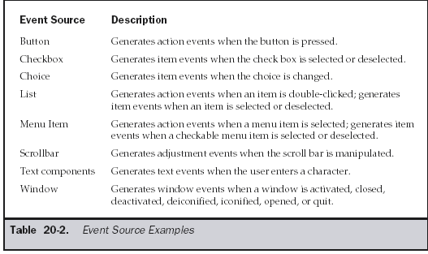
Sources of Events

Slide 11
Event Listener Interfaces
  Listeners are created by implementing one or more of the interfaces defined by the java.awt.event package.
  When an event occurs, the event source invokes the appropriate method defined by the listener and provides an event object as its argument.

Slide 12
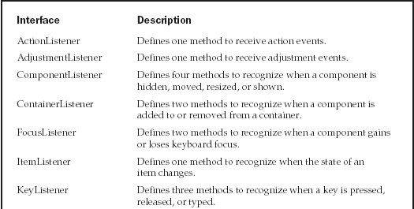

Slide 13
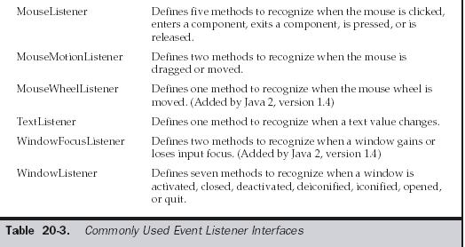

Slide 14
The ActionListener Interface
This interface defines the actionPerformed( ) method that is invoked when an action event occurs. Its general form is shown here:
void actionPerformed(ActionEvent ae)

Slide 15
public class Mouse1 extends Applet implements ActionListener
{
Button b1,b2,b3;
public void init()
{
b1=new Button("RED");
b2=new Button("Green");
b3=new Button("Blue");
add(b1);
add(b2);
add(b3);
b1.addActionListener(this);
b2.addActionListener(this);
b3.addActionListener(this);
}
public void actionPerformed(ActionEvent e)
{
showStatus("inside paint");
if(e.getSource().equals(b1))
{
this.setBackground(Color.red);
showStatus("inside paint and red color");
}
if(e.getSource().equals(b2))
{
showStatus("inside paint and green");
this.setBackground(Color.green);
}
if(e.getSource().equals(b3))
{
showStatus("inside paint and blue color");
this.setBackground(Color.blue);
}
}

Slide 16
The AdjustmentListener Interface
This interface defines the adjustmentValueChanged( ) method that is invoked when an adjustment event occurs. Its general form is shown here:
void adjustmentValueChanged(AdjustmentEvent ae)

Slide 17
The ComponentListener Interface
This interface defines four methods that are invoked when a component is resized, moved, shown, or hidden. Their general forms are shown here:
void componentResized(ComponentEvent ce)
  void componentMoved(ComponentEvent ce)
  void componentShown(ComponentEvent ce)
  void componentHidden(ComponentEvent ce)

Slide 18
The ContainerListener Interface
This interface contains two methods. When a component is added to a container, componentAdded( ) is invoked. When a component is removed from a container, componentRemoved( ) is invoked.
Their general forms are shown here:
void componentAdded(ContainerEvent ce)
Void componrntListener(ContainerEvrnt ce)
void componentRemoved(ContainerEvent ce)

Slide 19
The FocusListener Interface
This interface defines two methods. When a component obtains keyboard focus, focusGained( ) is invoked. When a component loses keyboard focus, focusLost( ) is called. Their general forms are shown here:
void focusLost(FocusEvent fe)
void focusGained(FocusEvent fe)

Slide 20
The ItemListener Interface
This interface defines the itemStateChanged( ) method that is invoked when the state of an item changes. Its general form is shown here:
void itemStateChanged(ItemEvent ie)

Slide 21
public class JCheckBoxDemo extends JApplet implements ItemListener
{
JTextField jtf=new JTextField(" ");
JCheckBox cb = new JCheckBox("C");
JCheckBox cb1 = new JCheckBox("CE");
JCheckBox cb2 = new JCheckBox("CSE");
public void init()
{
Container c = getContentPane();
c.setLayout(new FlowLayout());
// Create icons
c.add(cb);
c.add(cb1);
cb1.addItemListener(this);
cb.addItemListener(this);
cb2.addItemListener(this);
c.add(cb2);
c.add(jtf);
}
public void itemStateChanged(ItemEvent e) {
if(e.getSource()==cb)
{
jtf.setText(cb.getText());
}
if(e.getSource()==cb1)
{
jtf.setText(cb1.getText());
}
if(e.getSource()==cb2)
{
jtf.setText(cb2.getText());
}
}
}

Slide 22
The KeyListener Interface
This interface defines three methods. The keyPressed( ) and keyReleased( ) methods are invoked when a key is pressed and released, respectively. The keyTyped( ) method is invoked when a character has been entered.
    void keyPressed(KeyEvent ke)
    void keyReleased(KeyEvent ke)
    void keyTyped(KeyEvent ke)

Slide 23
import java.applet.Applet;
import java.awt.Label;
import java.awt.TextField;
import java.awt.event.KeyEvent;
import java.awt.event.KeyListener;
public class keytest extends Applet implements KeyListener
{ public void init()
{
Label l1=new Label("enter characters");
add(l1);
TextField t1=new TextField();
t1.addKeyListener(this);
add(t1);
}
public void keyTyped(KeyEvent e)
{
showStatus("recently typed charcter in the text area:" +e.getKeyChar());
}
public void keyPressed(KeyEvent e)
{ }
public void keyReleased(KeyEvent e)
{ }
}

Slide 24
The MouseListener Interface
This interface defines five methods.
If the mouse is pressed and released at the same point, mouseClicked( ) is invoked.
When the mouse enters a component, the mouseEntered( ) method is called.
When it leaves, mouseExited( ) is called.
The mousePressed( ) and mouseReleased( ) methods are invoked when the mouse is pressed and released, respectively
void mouseClicked(MouseEvent me)
void mouseEntered(MouseEvent me)
void mouseExited(MouseEvent me)
void mousePressed(MouseEvent me)
void mouseReleased(MouseEvent me)

Slide 25
public class clickcircle extends Applet implements MouseListener
{
public void init()
{
addMouseListener(this);
}
public void paint(Graphics g)
{
Random r = new Random();
Color c = new Color( r.nextInt(255), r.nextInt(255), r.nextInt(255) );
g.setColor(c);
g.fillOval(50, 50, 70, 70);
try
{
Thread.currentThread().sleep(300);
}
catch (InterruptedException ex) {}
}
public void mouseClicked(MouseEvent e)
{
repaint();
}
public void mousePressed(MouseEvent e)
{ }
public void mouseReleased(MouseEvent e) { }
public void mouseEntered(MouseEvent e) { }
public void mouseExited(MouseEvent e) { }

Slide 26
The MouseMotionListener Interface
This interface defines two methods. The mouseDragged( ) method is called multiple times as the mouse is dragged. The mouseMoved( ) method is called multiple times as the mouse is moved. Their general forms are shown here:
void mouseDragged(MouseEvent me)
void mouseMoved(MouseEvent me)

Slide 27
The MouseWheelListener Interface
This interface defines the mouseWheelMoved( ) method that is invoked when the mouse wheel is moved. Its general form is shown here.
void mouseWheelMoved(MouseWheelEvent mwe)

Slide 28
The TextListener Interface
This interface defines the textChanged( ) method that is invoked when a change occurs in a text area or text field. Its general form is shown here:
    void textChanged(TextEvent te)

Slide 29
The WindowFocusListener Interface
This interface defines two methods: windowGainedFocus( ) and windowLostFocus( ).
These are called when a window gains or losses input focus. Their general forms are shown here.
void windowGainedFocus(WindowEvent we)
void windowLostFocus(WindowEvent we)

Slide 30
Examples

Slide 31
// Demonstrate the mouse event handlers.
import java.awt.*;
import java.awt.event.*;
import java.applet.*;
public class MouseEvents extends Applet implements MouseListener, MouseMotionListener {
String msg = "";
int mouseX = 0, mouseY = 0; // coordinates of mouse
public void init() {
addMouseListener(this);
addMouseMotionListener(this);
}
// Handle mouse clicked.
public void mouseClicked(MouseEvent me) {
// save coordinates
mouseX = 0;
mouseY = 10;
msg = "Mouse clicked.";
repaint();
}

Slide 32
// Handle mouse entered.
public void mouseEntered(MouseEvent me) {
// save coordinates
mouseX = 0;
mouseY = 10;
msg = "Mouse entered.";
repaint();
}
// Handle mouse exited.
public void mouseExited(MouseEvent me) {
// save coordinates
mouseX = 0;
mouseY = 10;
msg = "Mouse exited.";
repaint();
}

Slide 33
// Handle button pressed.
public void mousePressed(MouseEvent me) {
// save coordinates
mouseX = me.getX();
mouseY = me.getY();
msg = "Down";
repaint();
}
// Handle button released.
public void mouseReleased(MouseEvent me) {
// save coordinates
mouseX = me.getX();
mouseY = me.getY();
msg = "Up";
repaint();
}

Slide 34
// Handle mouse dragged.
public void mouseDragged(MouseEvent me) {
// save coordinates
mouseX = me.getX();
mouseY = me.getY();
msg = "*";
showStatus("Dragging mouse at " + mouseX + ", " + mouseY);
repaint();
}
// Handle mouse moved.
public void mouseMoved(MouseEvent me) {
// show status
showStatus("Moving mouse at " + me.getX() + ", " + me.getY());
}
// Display msg in applet window at current X,Y location.
public void paint(Graphics g) {
g.drawString(msg, mouseX, mouseY);
}
}

Slide 35
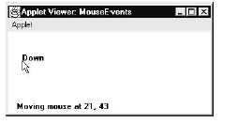

Slide 36
Handling Keyboard Events
// Demonstrate the key event handlers.
import java.awt.*;
import java.awt.event.*;
import java.applet.*;
/*
<applet code="SimpleKey" width=300 height=100>
</applet>
*/

Slide 37
public class SimpleKey extends Applet
implements KeyListener {
String msg = "";
int X = 10, Y = 20; // output coordinates
public void init() {
addKeyListener(this);
}
public void keyPressed(KeyEvent ke) {
showStatus("Key Down");
}
public void keyReleased(KeyEvent ke) {
showStatus("Key Up");
}

Slide 38
public void keyTyped(KeyEvent ke) {
msg += ke.getKeyChar();
repaint();
}
// Display keystrokes.
public void paint(Graphics g) {
g.drawString(msg, X, Y);
}
}

Slide 39
